Slide 1




Tears of a tiger by Sharon m. draper
Classic Book Talk by: Kendralyn Burr
Notes:
Hi, I am Kendralyn and I will be presenting a Book Talk on Tears of a Tiger by Sharon Draper. Tears of a Tiger was originally published October 1st 1994 by Simon Pulse.
I chose this book because it was a book that touched my heart when I was a teen. I feel that even though this books has been around for 25 years, the story is relevant today and can be relatable to teens. This story follows Andy Jackson as he struggles to cope with his role in the loss of a friend in a car crash.

Slide 2
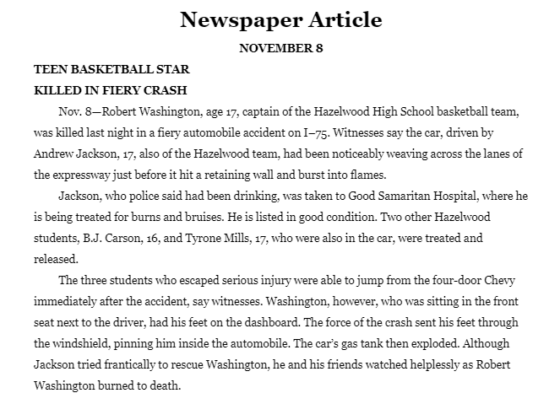
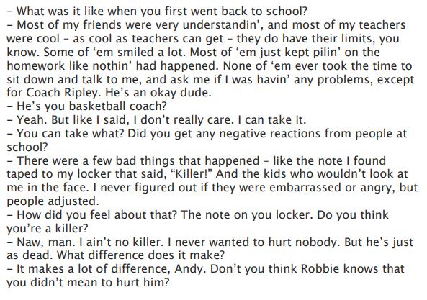
Excerpts
Chapter 1
Chapter 43
Notes:
Here are two samples from the book. The first one is a newspaper article that tells of the car crash that killed basketball star Robert Washington. Andrew “Andy” Jackson was driving the car after drinking beers to celebrate their teams win. I chose this sample because it describes the main event that kicks off the depression on Andy Jackson. While suffering through the loss of his teammate, Andy considers committing suicide. Andy’s parents encourage him to see a psychologist. Which is what leads to the second sample. Here Andy is talking to Dr. Carson, his psychologist about what it was like for him when he returned to school. He experiences some bullying with classmates writing notes that said “killer” on them.
If you enjoy this realistic fiction story, check out other books in the series. The second book, Forged By Fire which has themes of poverty and child abuse. The third book, Darkness before Dawn, follows Andy’s ex-girlfriend Keisha and has themes of death, grief, and forbidden romance.
Thank you for listening!

